Slide 1
Navigating UCloud to access RStudio
A few short slides to show step-by-step on how to use features of RUC’s HPC server
John Shorter

Slide 2
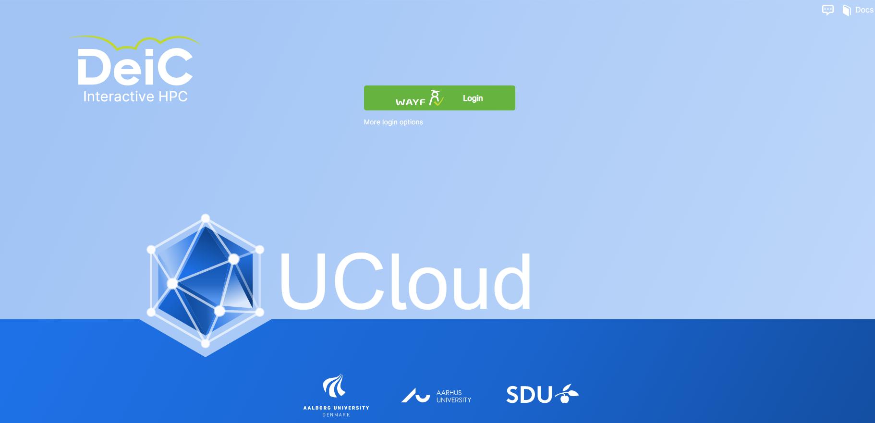
You will see this on your first time to https://cloud.sdu.dk/app/login

Slide 3
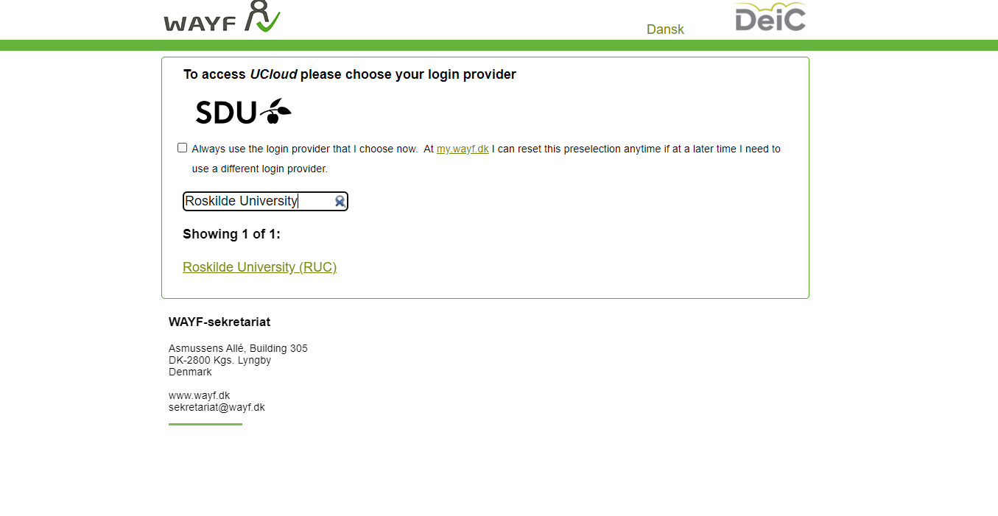
Click the green button and then search for Roskilde University

Slide 4
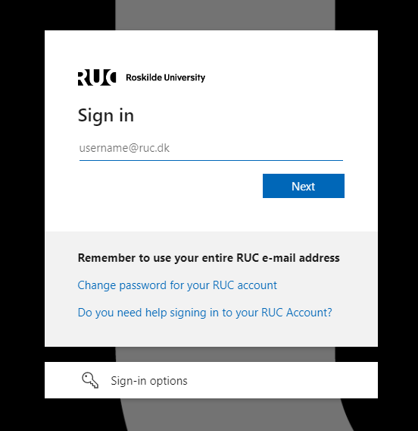
You will need to sign in

Slide 5
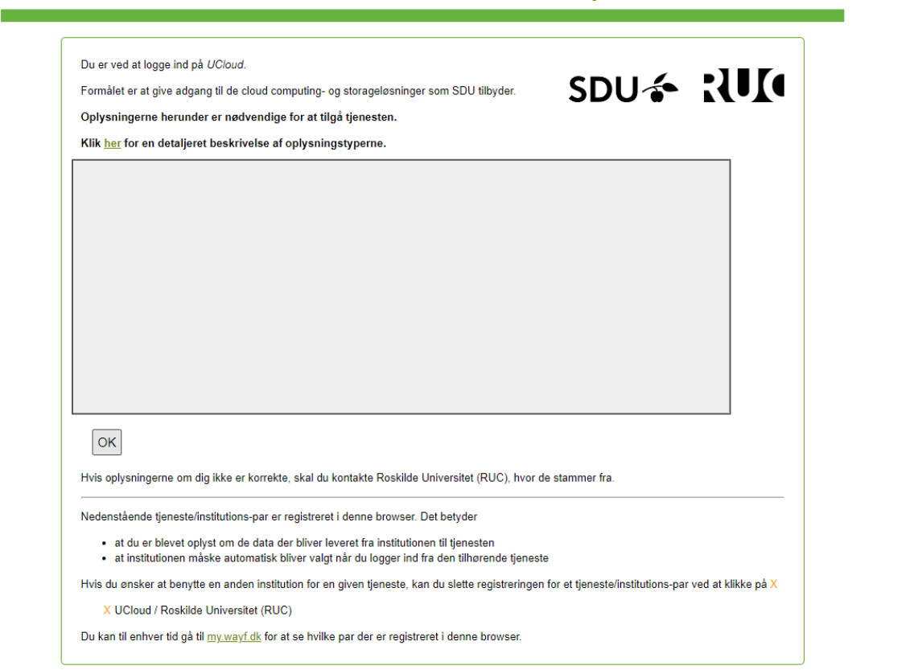
Click OK

Slide 6
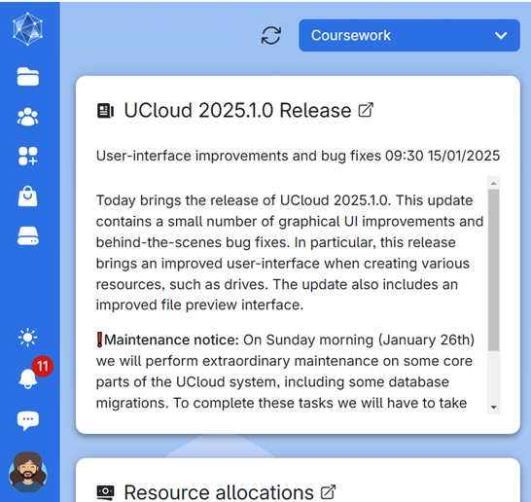
You should then be taken to the home page

Slide 7
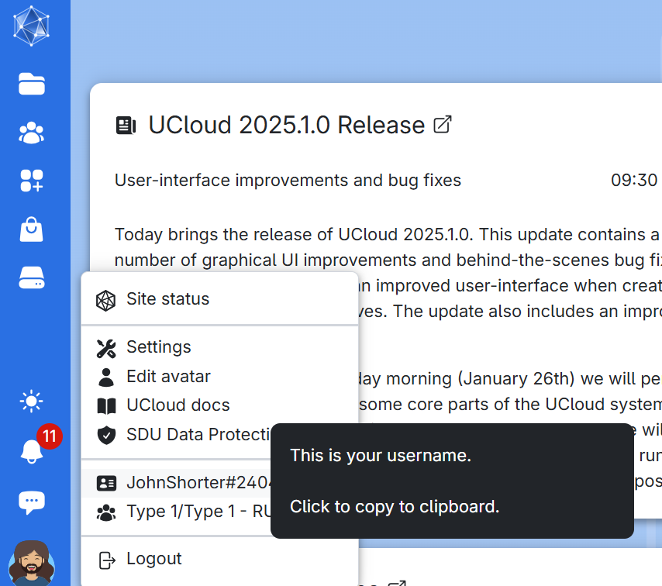
At the bottom left is your username for UCloud.

Slide 8
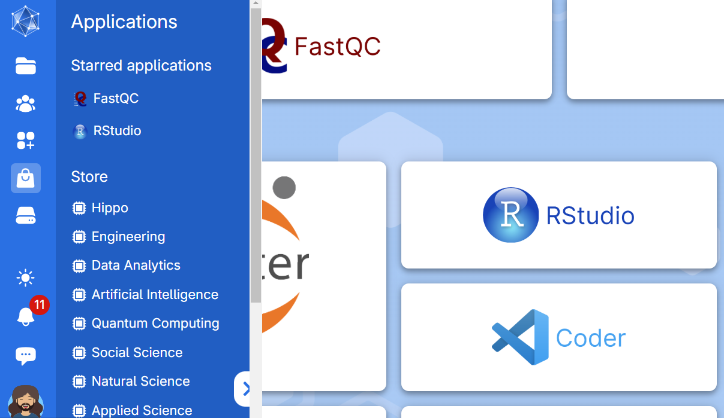
Click on Apps, then search for RStudio

Slide 9
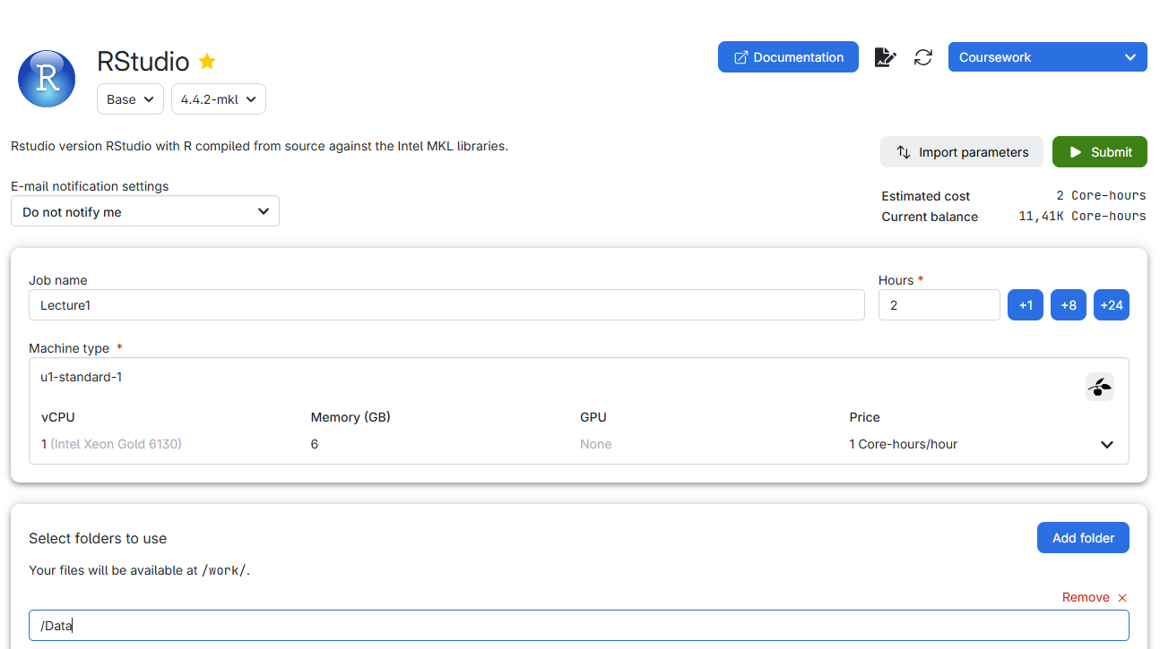
We select 4 options, the first 3 are Job name, Number of hours, and a machine type

Slide 10
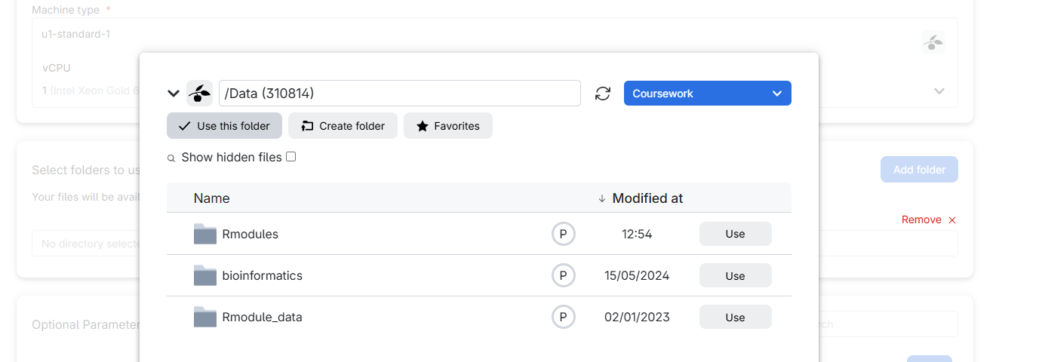
The 4th option is Add Folder and click Coursework

Slide 11
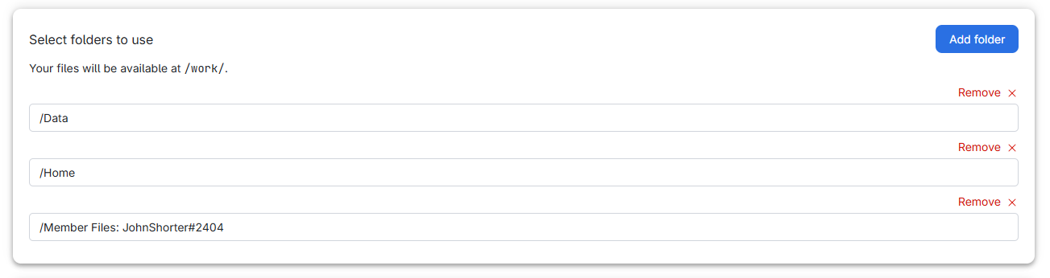
You are able to choose several folders, if you want to.

Slide 12
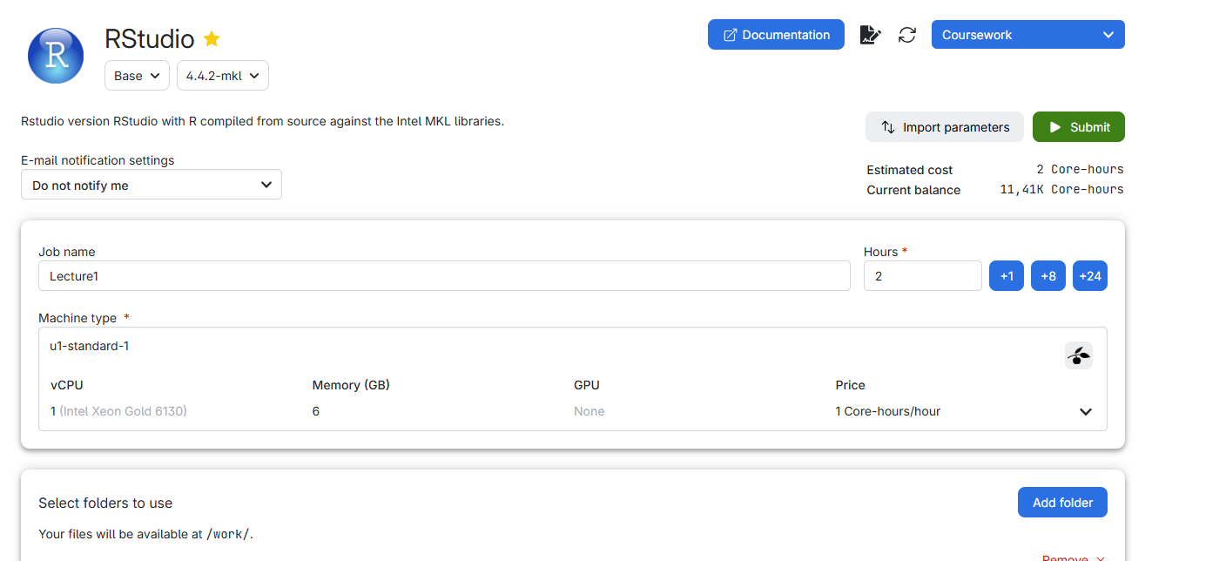
Very the 4 items and then hit the green submit button

Slide 13
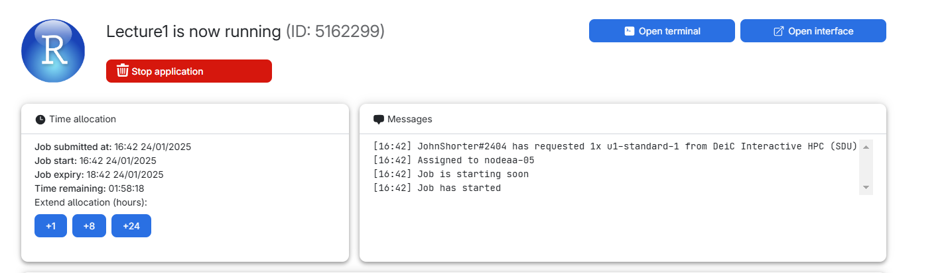
Once it runs, click Open Interface

Slide 14
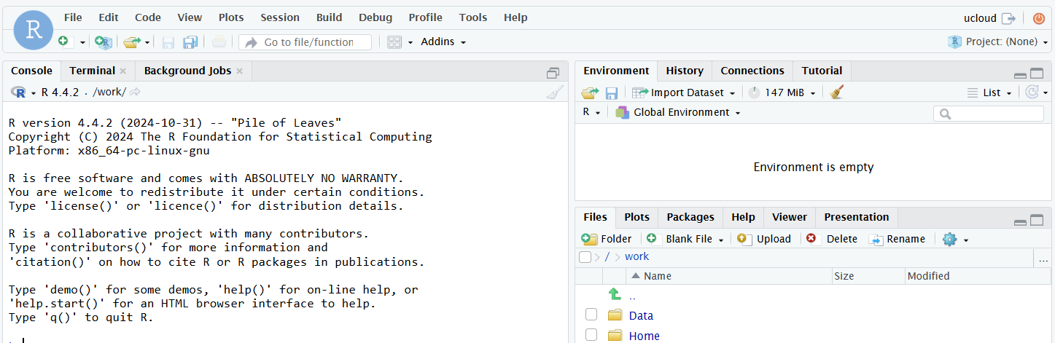
You are now using RStudio. Click on the yellow folders to open a script, or to import a dataset

Slide 15
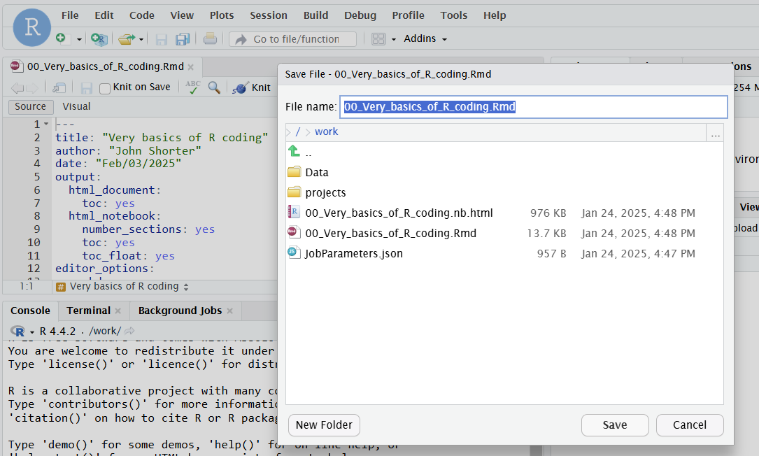
Choose File -> Save As, then the folder one directory above Data, because you are forbidden to save over the class files

Slide 16
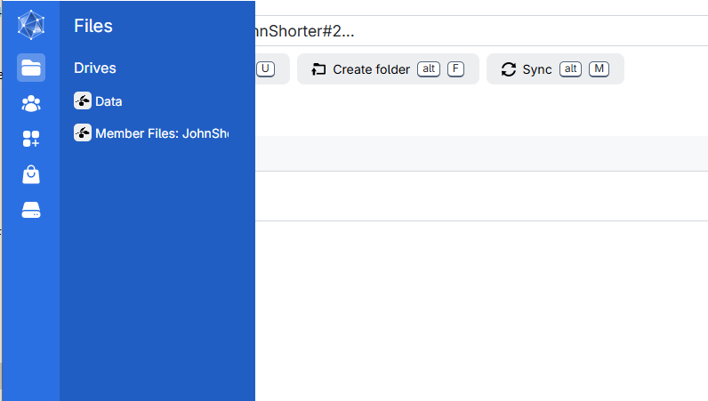
To download files saved in UCloud, choose go to the Files on the left side. Click on your name.

Slide 17
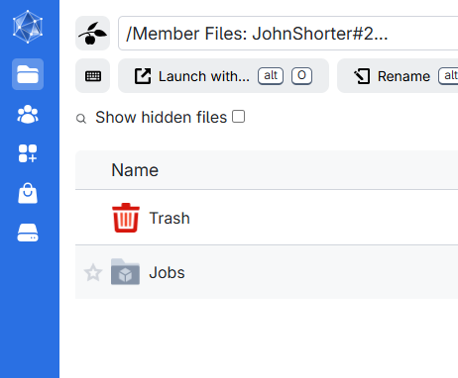
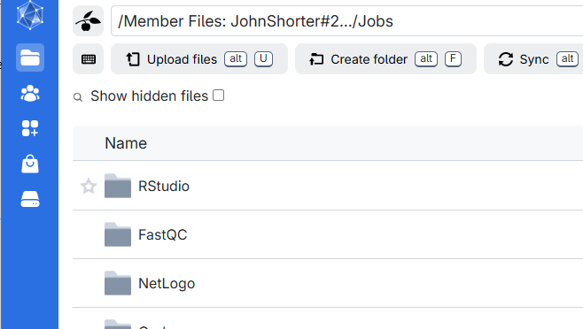
Click on the jobs and then RStudio

Slide 18
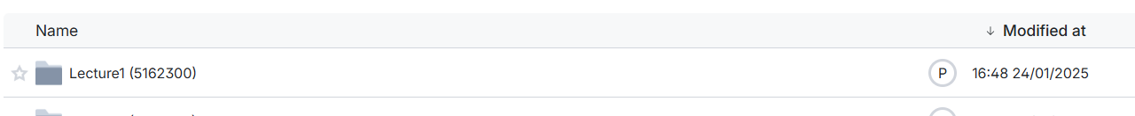
Choose the name of the job your ran, using the very descriptive name you provided earlier!

Slide 19
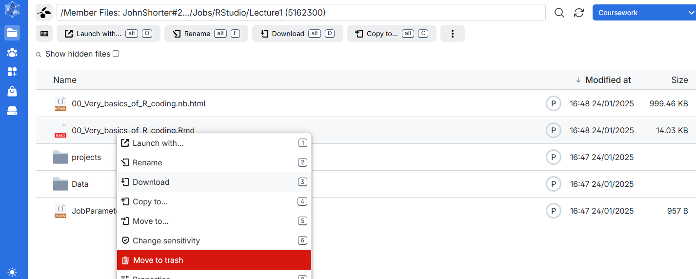
Right click on the file you want, and download it

Slide 20
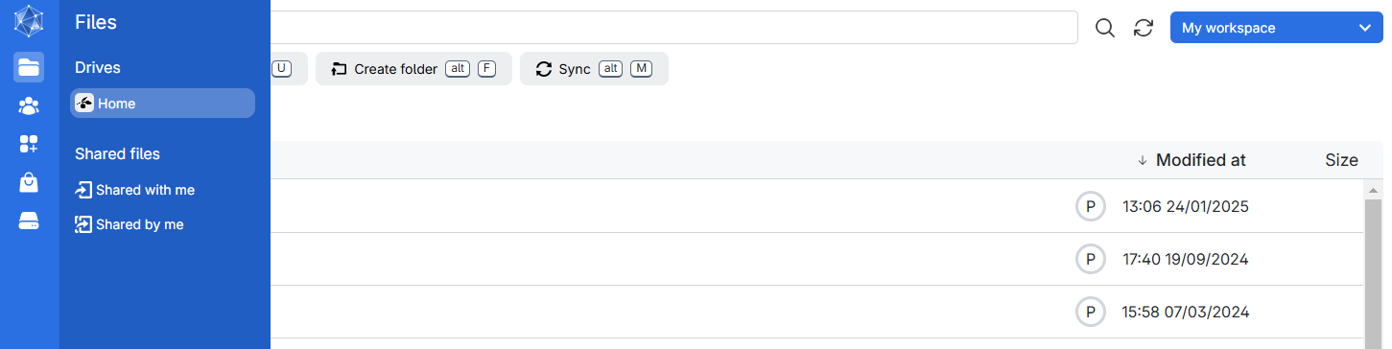
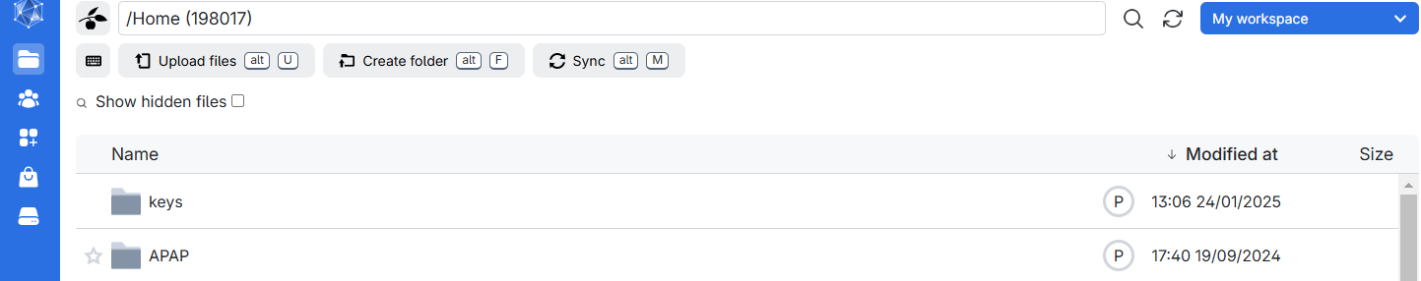
To upload a data file on Ucloud, we will need to select your own personal work space, then press the Upload files button

Slide 21
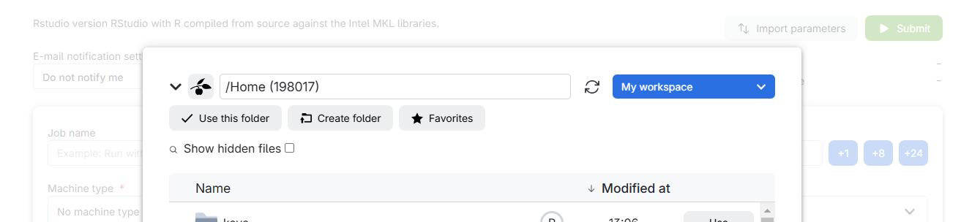
Remember, file you add here will be on “My Workspace” and not “Coursework”. You will need to select that folder when you start an R session to see your personal data files.

Slide 22
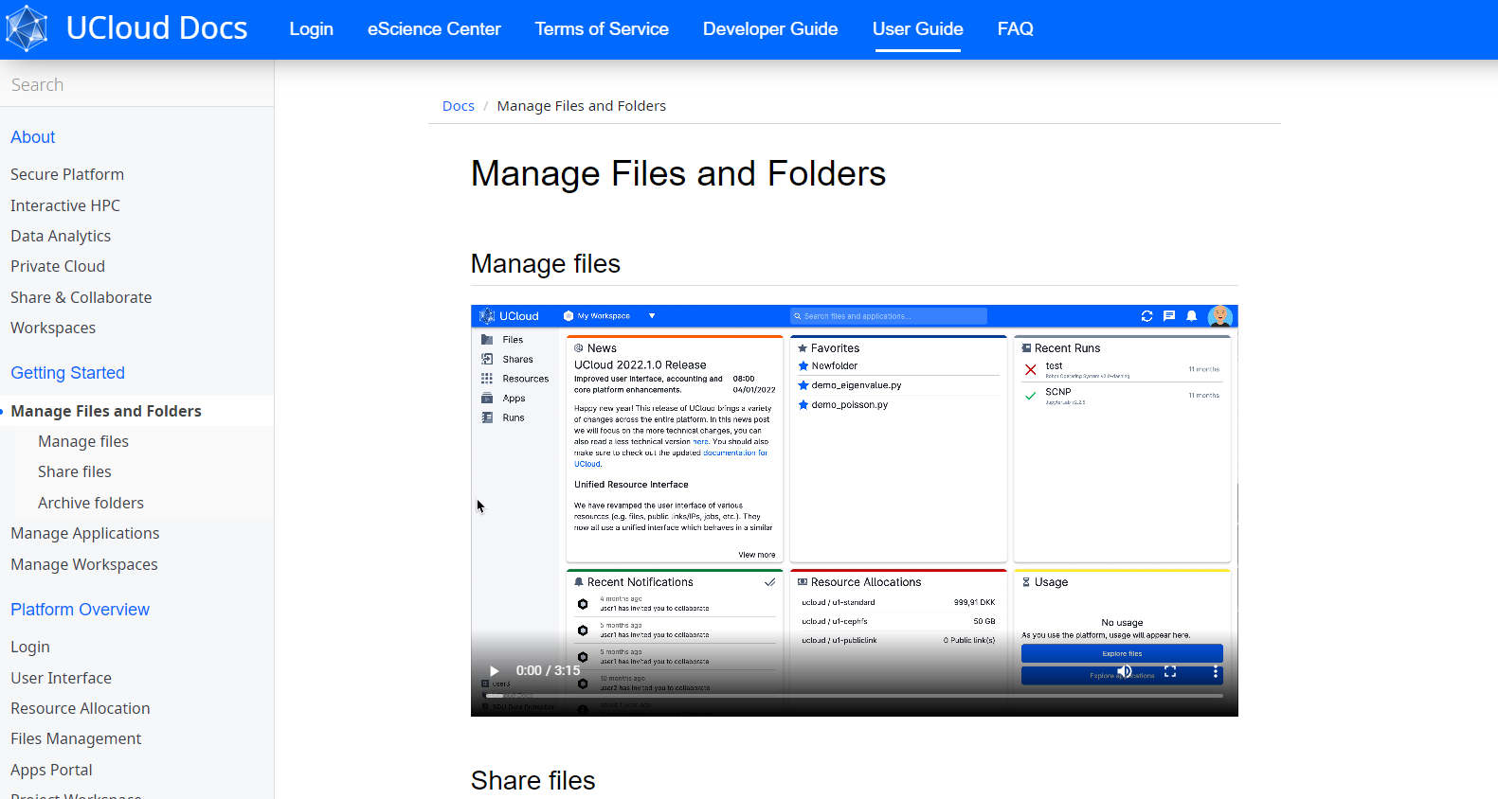
See https://docs.cloud.sdu.dk/tutorials/tutorial1.html for more information on UCloud support and a User Guide.

